Slide 1
Shadows of The Shepherd

Slide 2
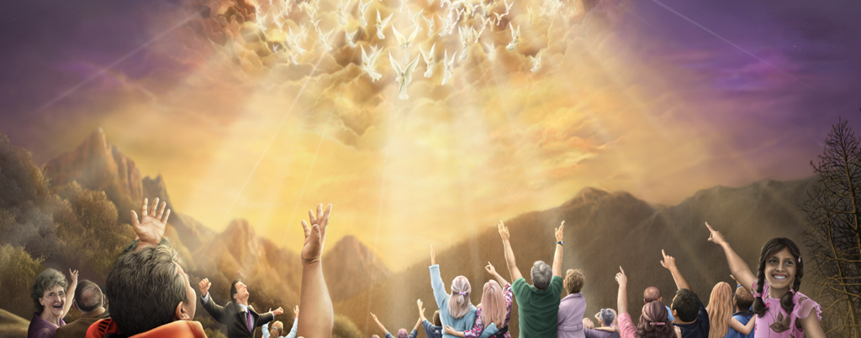
Notes:
Revelation 6 – Who will be able to stand?

Slide 3
“These are the ones who were not defiled with women, for they are virgins. These are the ones who follow the Lamb wherever He goes. These were redeemed from among men, being firstfruits to God and to the Lamb.” Revelation 14:4

Slide 4
“And in their mouth was found no deceit, for they are without fault before the throne of God.” Revelation 14:5

Slide 5
HOW CAN WE BE THIS CLEANSED PEOPLE?

Slide 6
Notes:
Psalm 77:13 – John 14:6 – John 14:29

Slide 7
Notes:
Sanctuary Prophetic Parable
Hebrews 9:9

Slide 8
Trajectory of the Types!

Slide 9
Notes:
Revelation 14 – hour of judgment

Slide 10
SPRING
FALL
50 Days
Passover
First Fruits
Trumpets
Tabernacles
Unleavened Bread
Pentecost
Day of Atonement

Slide 11
SPRING
FALL
50 Days
Passover
First Fruits
Trumpets
Tabernacles
Death of Christ
Resurrection
Advent Movement
Second Coming
1,000 Years
New Earth
Unleavened Bread
Pentecost
Day of Atonement
Holy Spirit
Burial
Began in 1844

Slide 12
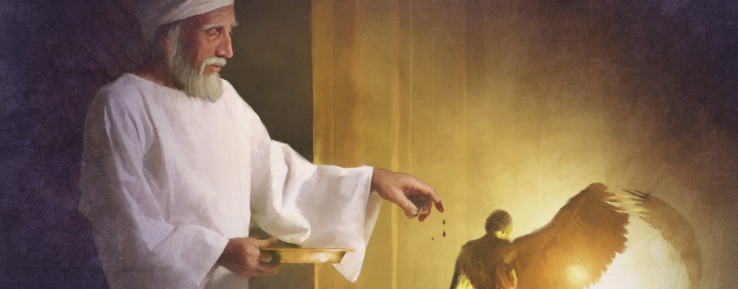
Notes:
We are living in the day of cleansing!
ATONEMENT

Slide 13
DAY OF ATONEMENT
DAY OF JUDGMENT

Slide 14
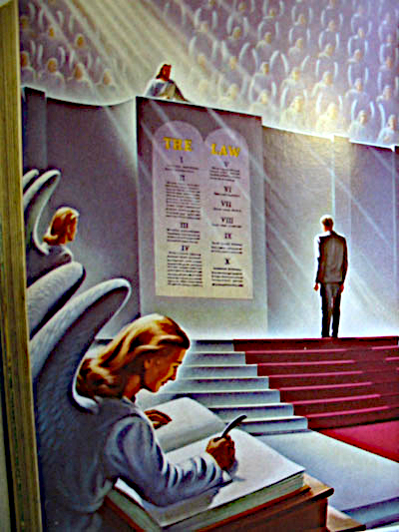
Notes:
LIVE IN YOUR SIN
MAGIC PRAYER – SAVED!

Slide 15
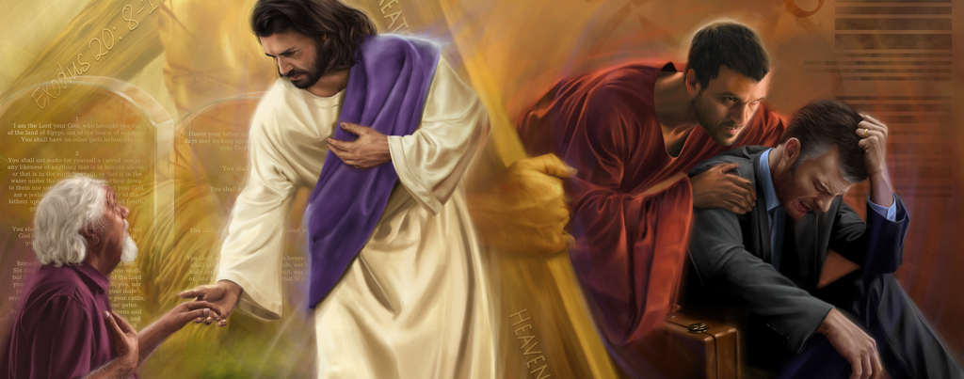
Notes:
Daniel 8:14 – cleansed
Matthew 1:21 – save FROM SIN

Slide 16
GUILT OF SIN
GRIP OF SIN

Slide 17
“For I am not ashamed of the gospel of Christ, for it is the power of God to salvation for everyone who believes, for the Jew first and also for the Greek.” Romans 1:16
Notes:
DYNAMIS – DYNAMITE!

Slide 18
“For in it the righteousness of God is revealed from faith to faith; as it is written, "THE JUST SHALL LIVE BY FAITH.” Romans 1:17

Slide 19
THE PROBLEM IS SIN!
WE ARE SICK!

Slide 20
“Jesus answered and said to them, "Those who are well have no need of a physician, but those who are sick.” Luke 5:31

Slide 21
“I have not come to call the righteous, but sinners, to repentance.” Luke 5:32

Slide 22
ISAIAH 1
What disease do we have?

Slide 23
LEPROSY
To be struck down!

Slide 24
“And when the cloud departed from above the tabernacle, suddenly Miriam became leprous, as white as snow. Then Aaron turned toward Miriam, and there she was, a leper.” Numbers 12:10

Slide 25
Aaron - “Please do not let her be as one dead, whose flesh is half consumed when he comes out of his mother's womb!” Numbers 12:12

Slide 26
SPREAD UNTIL REACHING A VITAL ORGAN. FORSAKEN BY FRIENDS AND RELATIVES. “UNCLEAN! UNCLEAN!”

Slide 27
DEATH NOT
ASSOCIATED
WITH DEITY
Notes:
LOOKED LIKE SOMEONE MOURNING!
MOURNING FOR HIMSELF!

Slide 28
“When a man has on the skin of his body a swelling, a scab, or a bright spot, and it becomes on the skin of his body like a leprous sore, then he shall be brought to Aaron the priest or to one of his sons the priests.” Leviticus 13:2

Slide 29
Leviticus 13 - Laws about Leprosy
Leviticus 14 - Laws for Cleansing

Slide 30
“Then the priest shall command to take for him who is to be cleansed two living and clean birds, cedar wood, scarlet, and hyssop.” Leviticus 14:4

Slide 31
The ceremony was a beautiful picture. A wild bird is killed, and another is dipped in its blood and set free. The leper was doomed for death and then released!
Notes:
This ceremony never happened with full blown leprosy! – Messianic – only HE could do it.

Slide 32
“His name is ‘the leper scholar,’ as it is written, Surely he hath borne our griefs, and carried our sorrows: yet we did esteem him a leper, smitten of God, and afflicted.”…” ‘When will the Messiah come?’
Sanhedrin 98a and 98b

Slide 33
“‘Go and ask him himself,’ was his reply. ‘Where is he sitting?’ ‘At the entrance.’ And by what sign may I recognize him?’ ‘He is sitting among the poor lepers…’” Sanhedrin 98a and 98b

Slide 34
“And many lepers were in Israel in the time of Elisha the prophet, and none of them was cleansed except Naaman the Syrian.” Luke 4:27

Slide 35
“And behold, a leper came and worshiped Him, saying, "Lord, if You are willing, You can make me clean.” Matthew 8:2

Slide 36
“Then Jesus put out His hand and touched him, saying, "I am willing; be cleansed." Immediately his leprosy was cleansed.” Matthew 8:3

Slide 37
“And Jesus said to him, "See that you tell no one; but go your way, show yourself to the priest, and offer the gift that Moses commanded, as a testimony to them.” Matthew 8:4

Slide 38
“And when John had heard in prison about the works of Christ, he sent two of his disciples.” Matthew 11:2

Slide 39
“And said to Him, “Are You the Coming One, or do we look for another?” Matthew 11:3

Slide 40
“Jesus answered and said to them, “Go and tell John the things which you hear and see: The blind see and the lame walk; the lepers are cleansed and the deaf hear; the dead are raised up and the poor have the gospel preached to them.” Matthew 11:4-5

Slide 41
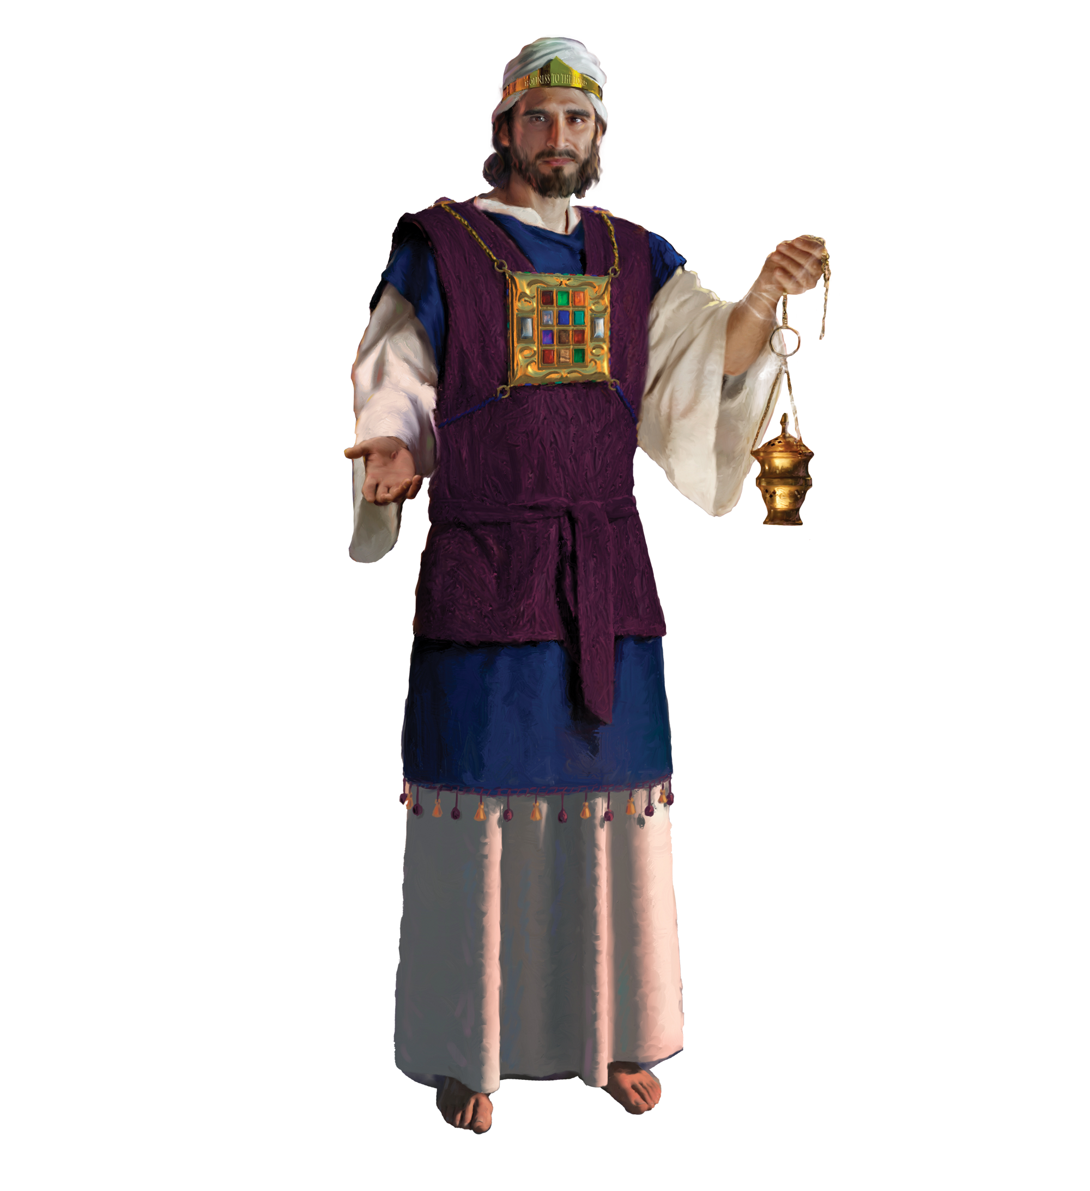
“But ye are a chosen generation, a royal priesthood, an holy nation, a peculiar people; that ye should shew forth the praises of him who hath called you out of darkness into his marvellous light.”
1 Peter 2:9
Notes:
Leper was cleansed and anointed like a priest!

Slide 42
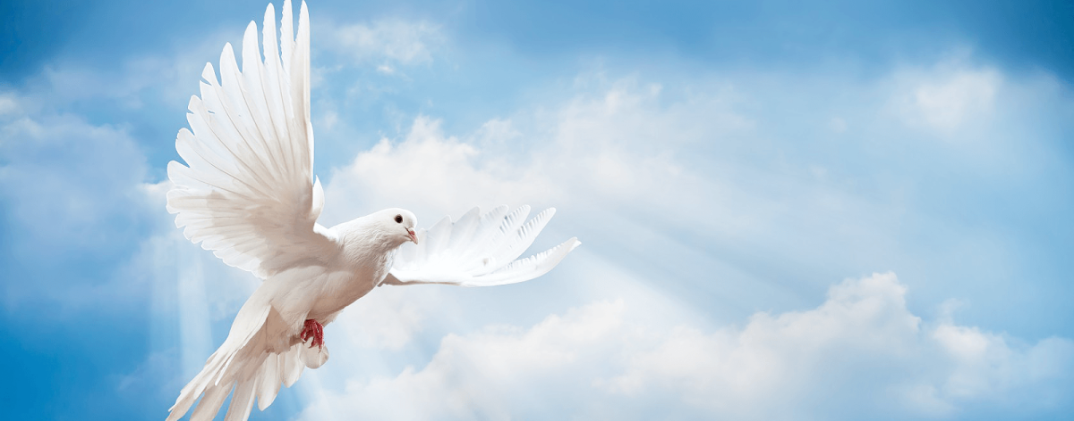
Notes:
This unusual ritual can be summarized with these points:
· This happened outside the camp, away from the normal conduct of the system of sacrifice.
· There, a living thing of the heavens was sacrificed in an earthen vessel.
· Even as the bird was killed, it was cleansed (by the running water).
· This death, associated with water and blood, was applied to the leper, and applied perfectly (seven times) in connection with a living bird.
· The sacrificial blood was also applied to scarlet yarn and a piece of wood, together with hyssop.
· Bearing the mark of sacrifice, the living bird flew away, ascending to the heavens and out of sight.
In a remarkable way, this unusual ritual points to the future work of the Messiah, who would cleanse those stained with the leprosy of sin.
· Jesus was sacrificed outside the camp (Hebrews 13:11-13).
· Jesus was the Man from heaven (John 3:13, 6:38).
· Jesus remained cleansed and holy (Acts 2:27) even in His death, becoming sin (2 Corinthians 5:21) without becoming a sinner.
· Jesus came by water and blood (1 John 5:6) and died in association with blood and water (John 19:34-35)
· Jesus died in association with scarlet cloth (Matthew 27:28).
· Jesus died in association with wood (John 19:17-18)
· Jesus died in association with hyssop (John 19:29).
· Jesus lived, bearing the marks of His death (John 20:27).
· Jesus ascended to heaven, out of human sight (Acts 1:9).
There is a sense in which the living bird set free points to the resurrected Jesus. But it also points to the one healed and free from their leprosy, including the leprosy of sin; they are resurrected and free in the resurrected Jesus Christ.
3. (8-9) The cleansing of the leper’s body.
The recovered leper would start all over again as if he was a newborn baby – as if he was born again.

Slide 43
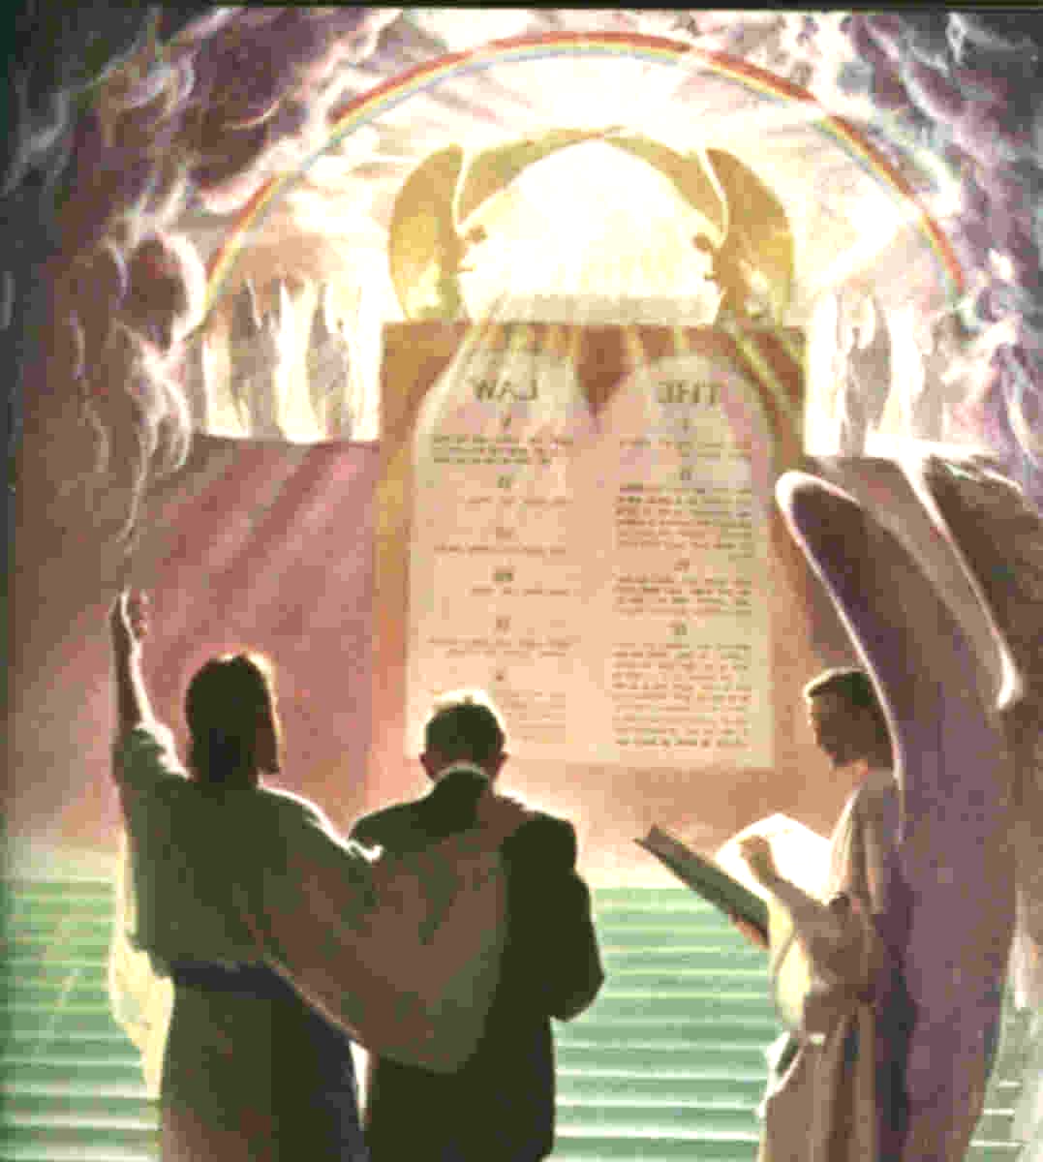
Notes:
Revelation 5 – lamb as though he had been slain
Hebrews 4:14-16

Slide 44
Notes:
Get back to the garden!

