Slide 2
Friendship Evangelism

Slide 5
Hundred Workers Where Now Is One
Time is short. Workers for Christ are needed everywhere. There should be one hundred earnest, faithful laborers in home and foreign mission fields where now there is one. The highways and the byways are yet unworked. Urgent inducements should be held out to those who ought now to be engaged in missionary work for the Master.
—Fundamentals of Christian Education, 488 (1903).

Slide 6
The Highest Calling
There must be no belittling of the gospel ministry. No enterprise should be so conducted as to cause the ministry of the Word to be looked upon as an inferior matter. It is not so. Those who belittle the ministry are belittling Christ. The highest of all work is ministry in its various lines, and it should be kept before the youth that there is no work more blessed of God than that of the gospel minister.
Evangelism, The Need of Evangelistic Workers

Slide 7
“I am coming quickly; hold fast what you have, so that no one will take your crown.”
Revelation 3:11

Slide 8
“He who testifies to these things says, “Yes, I am coming quickly.” Amen. Come, Lord Jesus.”
Revelation 22:20

Slide 9
and saying, “The time is fulfilled, and the kingdom of God is at hand; repent and believe in the gospel.”
Mark 1:15

Slide 10
“Repent, for the kingdom of heaven is at hand.”
Matthew 3:2

Slide 11
“Day after day is passing into eternity, bringing us nearer to the close of probation. As never before we must pray for the Holy Spirit to be more abundantly bestowed upon us, and we must look for its sanctifying influence to come upon the workers, that those for whom they labor may know that they have been with Jesus and have learned of Him.”
—Gospel Workers, Nearing the End

Slide 12
“We need spiritual eyesight, that we may see the designs of the enemy, and as faithful watchmen proclaim the danger. We need power from above, that we may understand, as far as the human mind can, the great themes of Christianity and their far-reaching principles.”
—Gospel Workers, Nearing the End

Slide 13
“Those who are under the influence of the Spirit of God will NOT be fanatical, but calm and steadfast, free from extravagance in thought, word, or deed. Amid the confusion of delusive doctrines, the Spirit of God will be a guide and a shield to those who have not resisted the evidences of truth, silencing every other voice but that which comes from Him who is the truth.”
—Gospel Workers, Nearing the End

Slide 14
Self Preparation
Preservation
Soil Preparation
Harvesting
Seed Planting
Cultivation
Notes:
You can’t give what you don’t have!

Slide 15
Die to Self (Church Mission, Revival)
Baptize, Nurture
(Repeat the process)
Daily Walk
(Prayer & Study Life)
Share and Teach The Word
(Personal & Public)
Make Friends
(Time, Trust, Truth)

Slide 16
Notes:
Many are caught in the web!

Slide 18
“The world will be convinced, not by what the pulpit teaches, but by what the church lives”
Testimonies for the Church, vol. 7, p. 16

Slide 19
People need to know the person before the pew.

Slide 20
People need to know the person before the pew.
People need to know see our passion before they see the prophecies.

Slide 21
People don’t care how much you know until they know how much you care.

Slide 22
Process VS Event

Slide 23
Seize opportunities
We all need to look for opportunities to begin a relationship with someone. Pray that God will reveal to you where He is working.
Jesus used His thirst as a way to reach the Samaritan woman at the well (John 4).
Jesus used Nicodemus’ curiosity as a path to friendship (John 3).
.
Paul even used idols to build a bridge with the Athenians (Acts 17).

Slide 24
Seize opportunities
Pray that the Lord will give you vision to recognize openings for relationships that will lead people to Jesus. A well, a cup of water, a pagan idol, can be used by the Holy Spirit to reach hearts.

Slide 25
Intentionality
Be intentional about building relationships with people: socialize with them; love them; meet their needs; invest in their lives.

Slide 26
Several research studies of lasting adult conversions show:
Their length was an average of about three years, during which they were on a process of inquiry.
For more than 60 percent of conversions, a serious life problem played a large part in starting people on their journey.

Slide 27
Several research studies of lasting adult conversions show:
In more than 70 percent of conversions, a relationship with a Christian(s) who subsequently turned out to be praying for them was the strongest factor—far more significant than reading the Bible, tracts, books, or watching videos. They eventually wanted what they saw modeled in their friends’ lives.
Most conversions take place in the context of church fellowship, rather than in isolation.”

Slide 28
Clearly identify the fact that you are a Christian in the course of normal conversation. Interject your beliefs that are based upon God’s Word.
Don’t hesitate to speak of the benefits and blessings of being a Christian.
When appropriate, give God the glory as you discuss good things that you experience (avoid excessive praise; it can sound artificial and hypocritical).
Don’t try to say everything at once.

Slide 29
Ask questions. Seek first to understand, then to be understood. Make your conversations dialogues, not monologues.
Be sensitive to their reactions; place yourself in their shoes.
As you share your faith, seek wisdom from God through prayer (James 1:5; Neh. 2:4).
When asked, explain the plan of salvation simply and clearly (Acts 18:24-26).

Slide 30
“Jesus saw in every soul one to whom must be given the call to His kingdom. He reached the hearts of the people by going among them as one who desired their good. He sought them in the public streets, in private houses, on the boats, in the synagogue, by the shores of the lake, and at the marriage feast.”
(The Desire of Ages, p. 151).

Slide 31
“He met them at their daily vocations, and manifested an interest in their secular affairs. He carried His instruction into the household, bringing families in their own homes under the influence of His divine presence. His strong personal sympathy helped to win hearts.”
(The Desire of Ages, p. 151).

Slide 33
There's a story I've been hearing
With a lesson that's most cheering
And I'm sure that you will want to hear it, too
Well, a man was eating pastry
And it must have been quite tasty,
When he thought of something he would like to do

Slide 34
He was sitting at his table
Eating all that he was able
When he spied a little ant upon the floor
Placing ant upon his pastry
Which he'd thought was very tasty
He was shocked to see the ant would eat no more

Slide 35
But instead he left the table
Ran as fast as he was able
Down the legs and then he raced across the floor
So the man gave close inspection
And he followed the direction
And he saw the ant rush through the open door

Slide 36
On the street the ant found others
I don't know if friends or brothers
But what he said just seemed to thrill them all
And not one made an indictment
Every ant with great excitement
Turned to follow him in answer to his call

Slide 37
He led them to that table
Where they ate all they were able
And the man stood by inspired by what he'd seen
As he thought of all his neighbors
And how limited his labors
He was shamed to be so selfish and so mean

Slide 38
We believe the gospel story
And we long for heaven's glory
Let the world behold our hope to us is real
And the message will grow sweeter
And our feet will be much fleeter
When we get the ant's evangelistic zeal!

Slide 39
Notes:
Daughter learning to drive.
Did everything right – except SLOW DOWN!

Slide 40
Time
Trust
Truth

Slide 41
People need to know the person before the pew.
People need to know see our passion before they see the prophecies.

Slide 42
My diet was different
My language was different
My weekends were different
My morals were different
My family was different
They called me Brother Daniel

Slide 43
Notes:
Sean working out.

Slide 44
Notes:
Helped Courtney install dryer.

Slide 45
“I would like to study the Bible with you on one condition, …

Slide 46
Unidentified Church
Notes:
Shady Grove - confidential

Slide 47
Notes:
Ashley Holcomb – corner store
Bible study invite
Senior portraits for free
Mom – has cancer – Bible studies now for several months
Wife cooked bread
Continuing to study now

Slide 48
Family

Slide 50
“But that on the good ground are they, which in an honest and good heart, having heard the word, keep it, and bring forth fruit with patience.”
Luke 8:15

Slide 51
“But the fruit of the Spirit is love, joy, peace, longsuffering, kindness, goodness, faithfulness,
Gal 5:23 gentleness, self-control. Against such there is no law.”
Galatians 5:22

Slide 52
“Here is the patience of the saints: here are they that keep the commandments of God, and the faith of Jesus.”
Revelation 14:12

Slide 53
“Philip findeth Nathanael, and saith unto him, We have found him, of whom Moses in the law, and the prophets, did write, Jesus of Nazareth, the son of Joseph.”
John 1:45

Slide 54
“And Nathanael said unto him, Can there any good thing come out of Nazareth? Philip saith unto him, Come and see.”
John 1:46
Notes:
Prejudice against Nazareth!

Slide 55
“Here is a lesson for all our ministers, colporteurs, and missionary workers. When you meet those, who, like Nathanael, are prejudiced against the truth, do not urge your peculiar views too strongly.”
Evangelism, p. 446

Slide 56
“Talk with them at first of subjects upon which you can agree. Bow with them in prayer, and in humble faith present your petitions at the throne of grace.”
Evangelism, p. 446

Slide 57
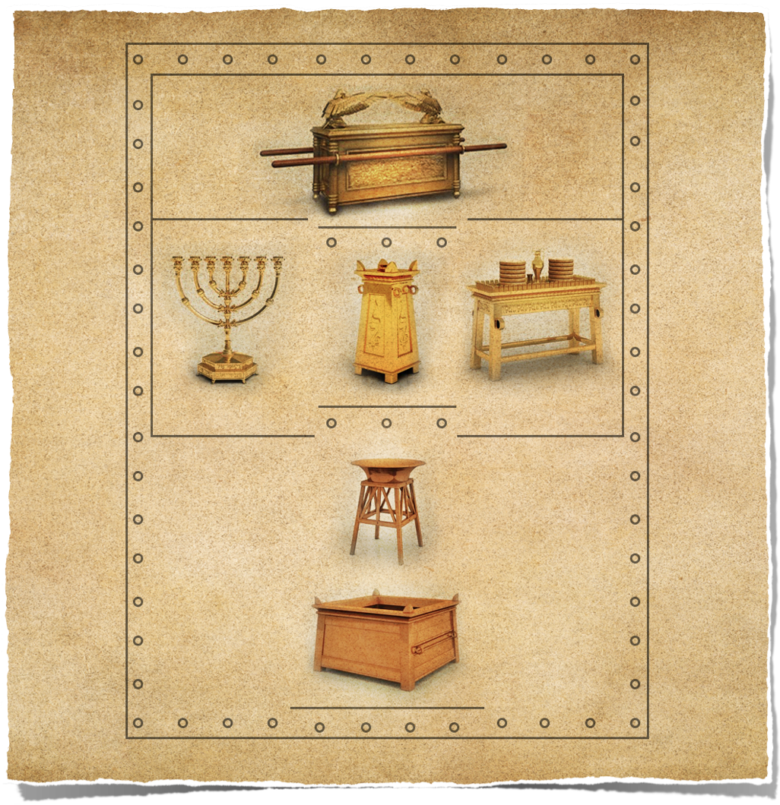
SANCTUARY WITNESS

Slide 58
What is a Seventh-day Adventist?

Slide 59
Did Jesus reveal everything to His disciples? Why or why not?

Slide 60
John 16:12–14

Slide 61
This principle remains true today. So often, following an evangelistic seminar, newly baptized individuals will excitedly declare, “I can’t wait to go home and tell my family all about who the Christ is!”

Slide 62
This principle remains true today. So often, following an evangelistic seminar, newly baptized individuals will excitedly declare, “I can’t wait to go home and tell my family all about who the Antichrist is!”

Slide 63
This well-meaning enthusiasm must quickly be redirected by reminding them of their own journey in truth and of the importance of revealing truth gradually, lest in their zeal they destroy all future witnessing opportunities.

Slide 64
“Now when they heard this, they were pricked in their heart, and said unto Peter and to the rest of the apostles, Men and brethren, what shall we do?”
Acts 2:37

Slide 65
How do we prick hearts?

Slide 68
Bake bread or cookies
Visit the sick
Invite a guest at church to your home
Ask questions, which will reveal your genuine interest in the person
Listen, listen, listen! (And then listen again)
Share what God has done for you

Slide 69
F
O
R
T

Slide 70
F
O
R
T
amily

Slide 71
F
O
R
T
amily
ccupation

Slide 72
F
O
R
T
amily
ccupation
eligion

Slide 73
F
O
R
T
amily
ccupation
eligion
estimony

Slide 74
Revelation 12:11

Slide 75
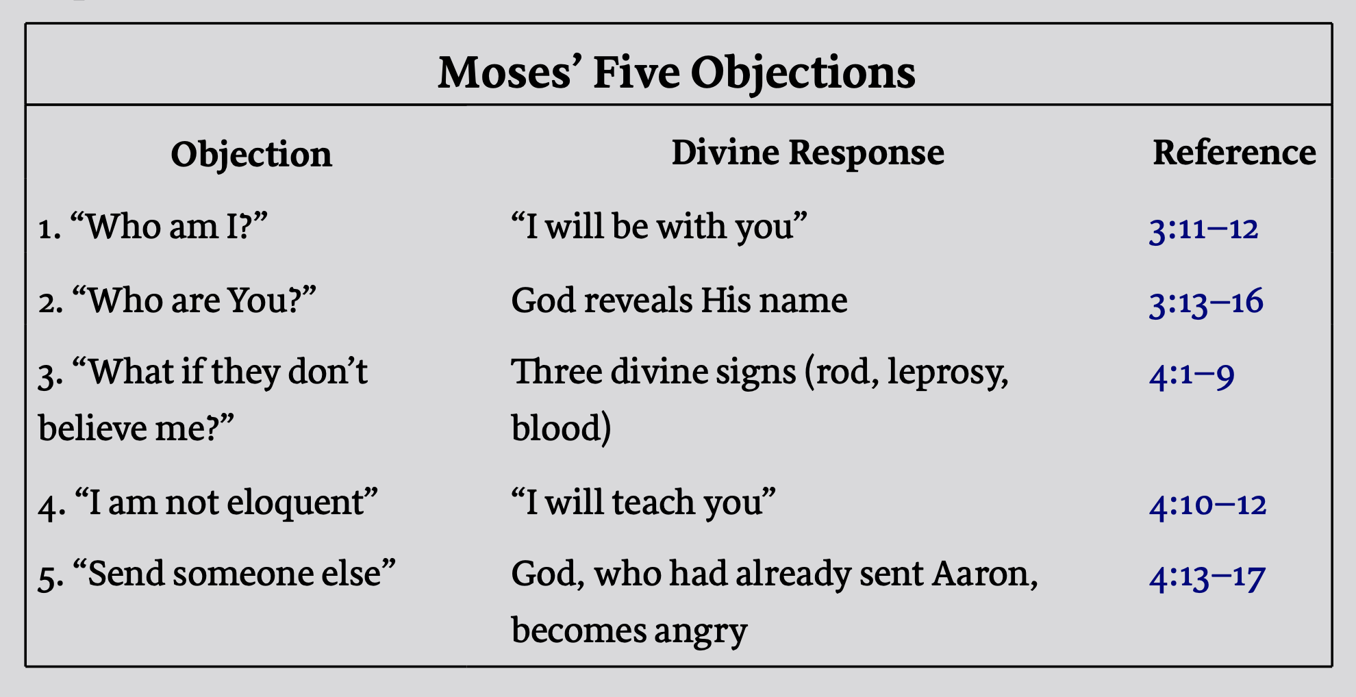

Slide 76
Jeremiah 1:4–9

Slide 77
Mark 10:17-22
Notes:
SAD STORY!

Slide 78
What if Jesus had said, “Well, I obviously wasn’t called into ministry! Look how he walked away.” Did Jesus, the greatest Missionary, know what it felt like to have someone He loved walk away from a saving relationship with God?

Slide 79
“And whoever will not receive you nor hear your words, when you depart from that house or city, shake off the dust from your feet.”
Matthew 10:14

Slide 80
Time
Trust
Truth

