Slide 1
Afcoe.org

Slide 3
THE EVANGELISM CYCLE

Slide 5
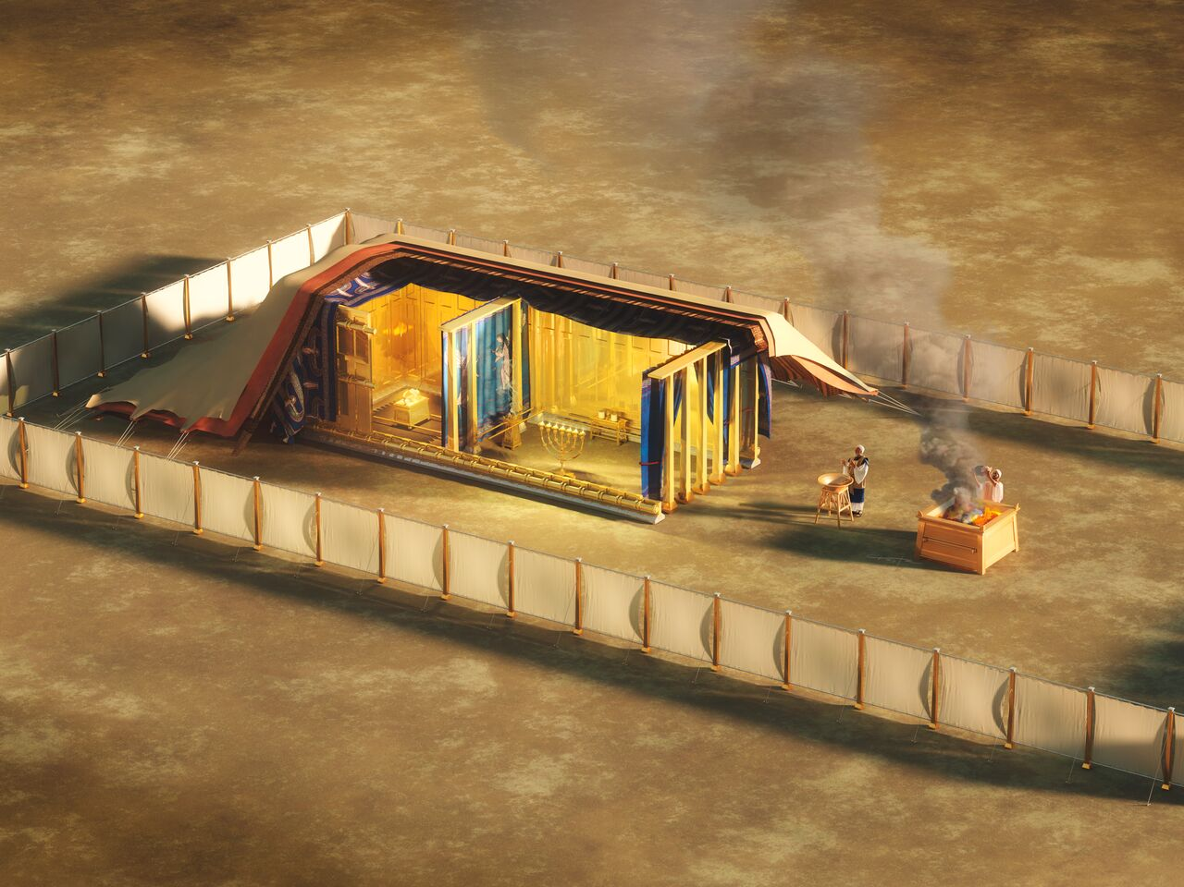

Slide 6
Christ's method alone will give true success in reaching the people.
Ministry of Healing, p. 143

Slide 7
Evangelism Cycle
(Personal & Church)

Slide 8
Evangelism Cycle
(Personal & Church)
1. Daily Communion:
Prayer & Study Life

Slide 12
Evangelism Cycle
(Personal & Church)
1. Daily Communion:
Prayer & Study Life

Slide 13
Evangelism Cycle
(Personal & Church)
1. Daily Communion:
Prayer & Study Life
2. Find Friends, Minister
to their Needs & Win
their Confidence & Trust
(Circle of Influence)

Slide 14
The Savior mingled with men as one who desired their good.
He showed His sympathy for them, ministered to their needs, and won their confidence.
Ministry of Healing, p. 143

Slide 15
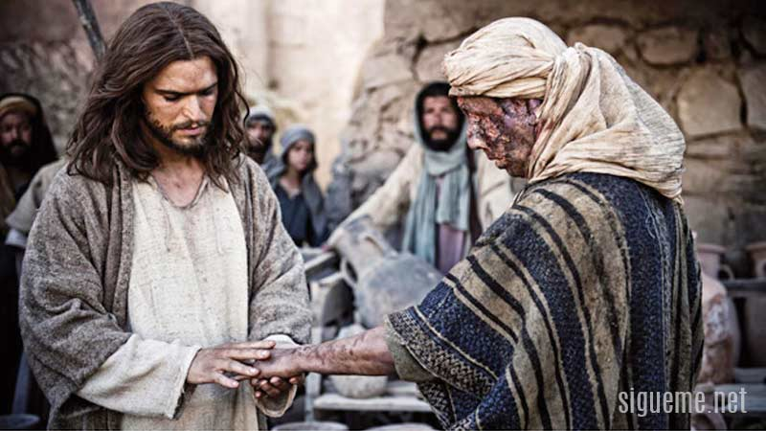

Slide 16
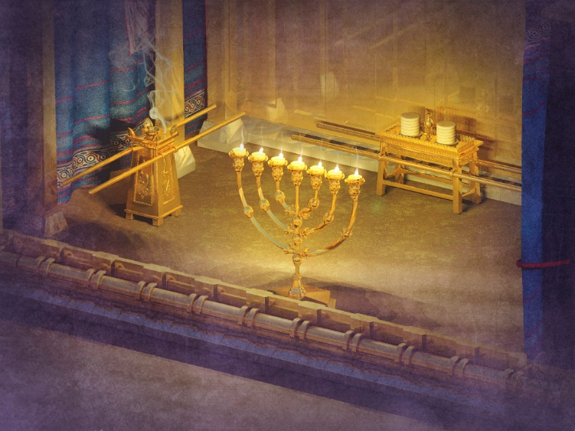

Slide 19
Evangelism Cycle
(Personal & Church)
1. Daily Communion:
Prayer & Study Life
2. Find Friends, Minister
to their Needs & Win
their Confidence & Trust
(Circle of Influence)

Slide 20
Evangelism Cycle
(Personal & Church)
1. Daily Communion:
Prayer & Study Life
2. Find Friends, Minister
to their Needs & Win
their Confidence & Trust
(Circle of Influence)
3. Share & Teach the Word
(Personal and Public)

Slide 21
The Everlasting Gospel
Revelation 14:6-12

Slide 26
Evangelism Cycle
(Personal & Church)
1. Daily Communion:
Prayer & Study Life
2. Find Friends, Minister
to their Needs & Win
their Confidence & Trust
(Circle of Influence)
3. Share & Teach the Word
(Personal and Public)

Slide 27
Evangelism Cycle
(Personal & Church)
4. Baptize, Nurture & Train New Believers
1. Daily Communion:
Prayer & Study Life
2. Find Friends, Minister
to their Needs & Win
their Confidence & Trust
(Circle of Influence)
3. Share & Teach the Word
(Personal and Public)

Slide 28
“Christ's method alone will give true success in reaching the people.”
Ministry of Healing, p. 143

Slide 29
Evangelism Cycle
(Personal & Church)
4. Baptize, Nurture & Train New Believers
1. Daily Communion:
Prayer & Study Life
2. Find Friends, Minister
to their Needs & Win
their Confidence & Trust
(Circle of Influence)
3. Share & Teach the Word
(Personal and Public)

Slide 31
Evangelism Cycle
(Personal & Church)
4. Baptize, Nurture & Train New Believers
1. Daily Communion:
Prayer & Study Life
2. Find Friends, Minister
to their Needs & Win
their Confidence & Trust
(Circle of Influence)
3. Share & Teach the Word
(Personal and Public)

Slide 38
Evangelism Cycle
(Personal & Church)
4. Baptize, Nurture & Train New Believers
1. Daily Communion:
Prayer & Study Life
2. Find Friends, Minister
to their Needs & Win
their Confidence & Trust
(Circle of Influence)
3. Share & Teach the Word
(Personal and Public)

Slide 40
Evangelism Cycle
(Personal & Church)
4. Baptize, Nurture & Train New Believers
1. Daily Communion:
Prayer & Study Life
2. Find Friends, Minister
to their Needs & Win
their Confidence & Trust
(Circle of Influence)
3. Share & Teach the Word
(Personal and Public)

Slide 46
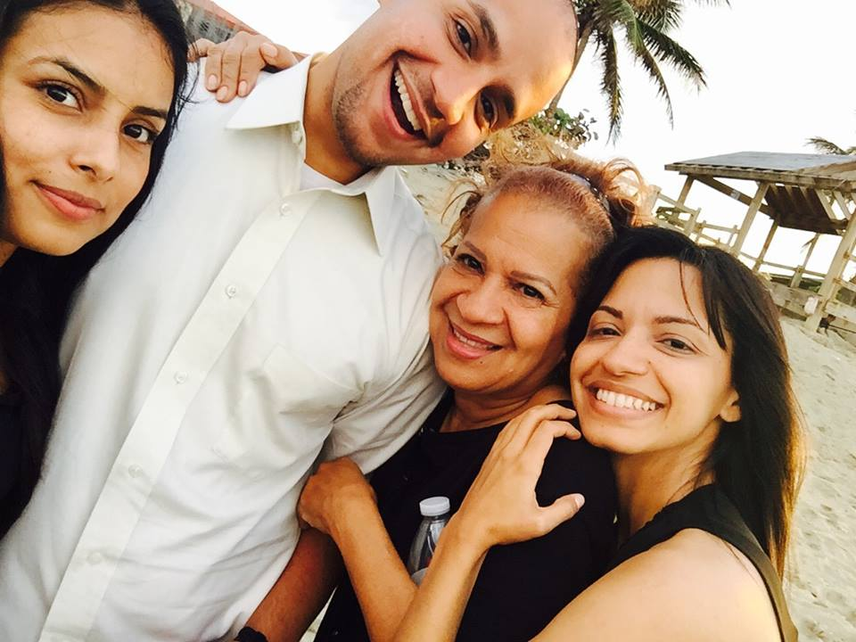

Slide 47
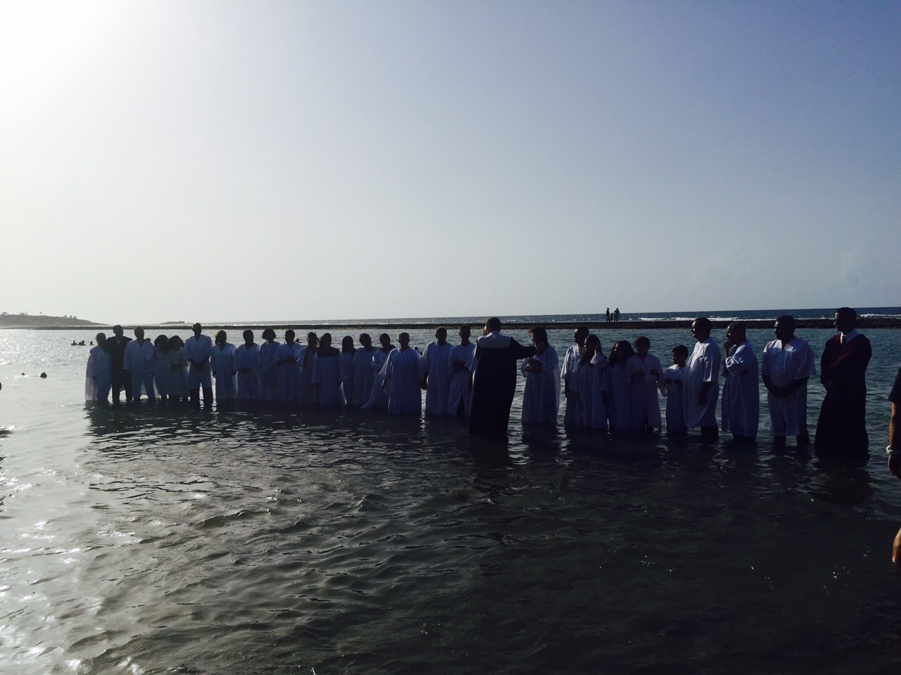

Slide 48
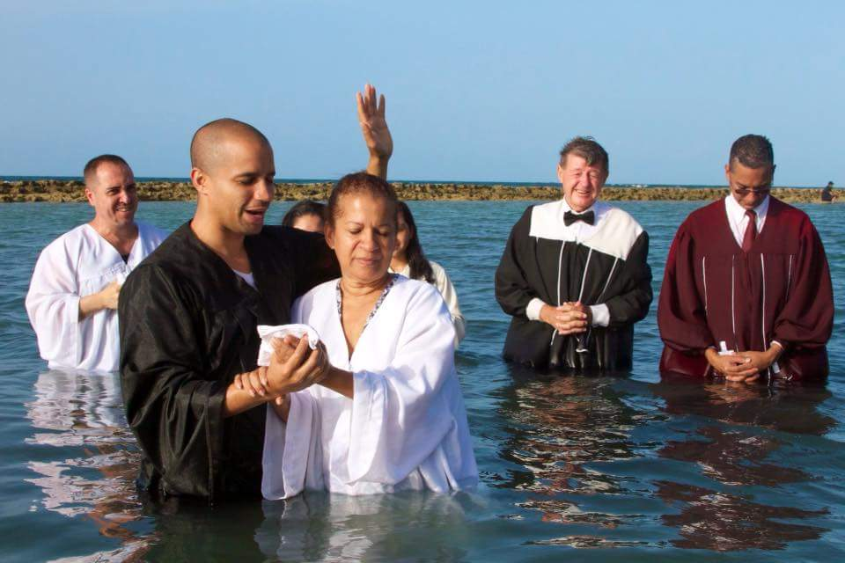

Slide 50
Reflection
If this church closed its doors tomorrow,
would your community notice the absence?
Are we having an impact in our community?
Consider how your church is collectively meeting the social, spiritual, emotional,
and physical needs around.
Am I contributing or just overserving?

Slide 51
Your AFCOE Challenge:
Do your neighbors know you? Your co-workers?
Have you approached and interacted with them to pray and see what their needs are?
Do they know that they can count on you to pray and intercede? Now is a perfect opportunity to go pray with them and see what their needs and are.

